Slide 1
Building daily CalLite model from scratch – daily version

Slide 2
Goals
Learn how to rebuild CalLite schematic North of Delta model from scratch using daily data
Including Delta operations and requirements will be saved for later
Review how WRESL routes water without actual channel routing like Muskingum method
Determine the validity and corroborate the results

Slide 3
North of Delta Daily 1-year model
Time period
August 2019-August 2020 (mostly water year 2020)
Progresses as phases and sub-phases which can be done on parallel paths
Feather River to Confluence
Yuba River to Confluence
Feather-Yuba to SacFeather confluence
Shasta to Red Bluff
Trinity to Red Bluff
Shasta-Trinity to SacFeather confluence

Slide 4
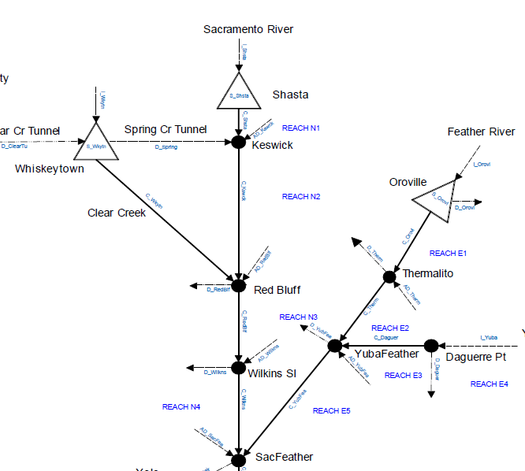
Schematic

Slide 5
Questons
What is the philosophy of using Accretion-Depletion (AD) terms?
How to estimate daily AD terms from available daily data?
Is it okay to estimate these terms using CDEC data or will I have to refer to CalSim II data?
With the

Slide 6
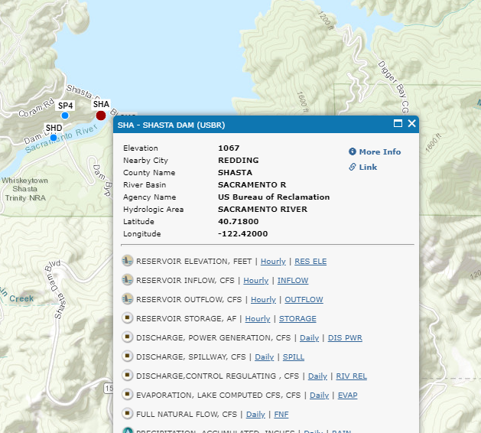
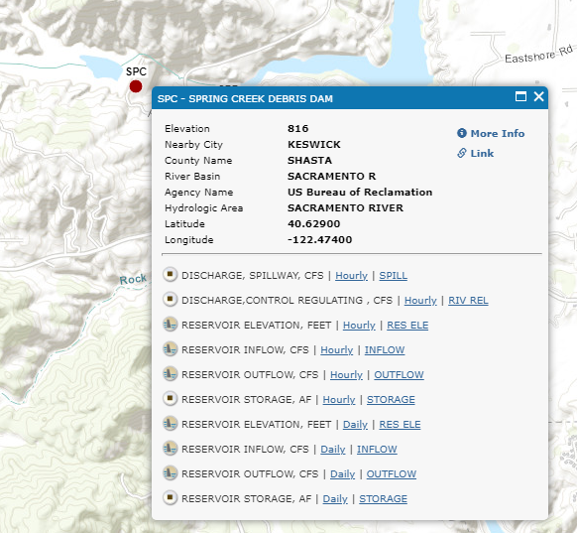
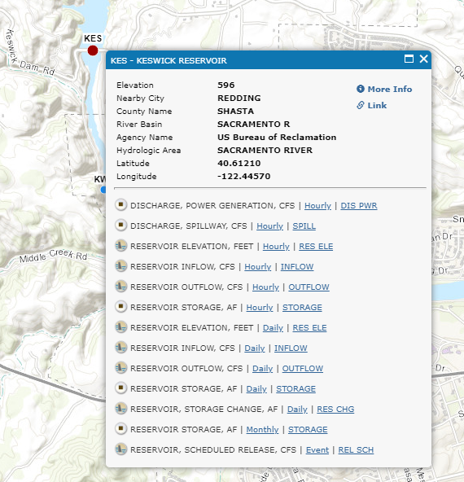
AD_KSWCK
Three components
Shasta dam (SHA) release
Inflow from Spring Creek (SPC)
Keswick dam release (KES)

Slide 7
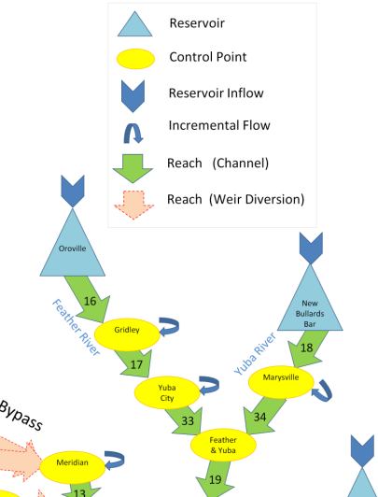
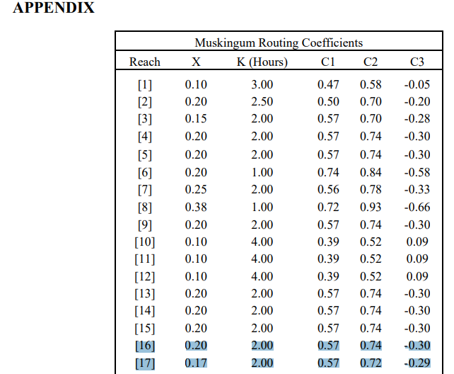
Connaughton (2014)
Sacramento Valley Integrated Reservoir Optimization Model (SVIROM): Flood Control linear program
Provided appendix with derived Muskingum routing coefficients
Reach 16 would be

Slide 8
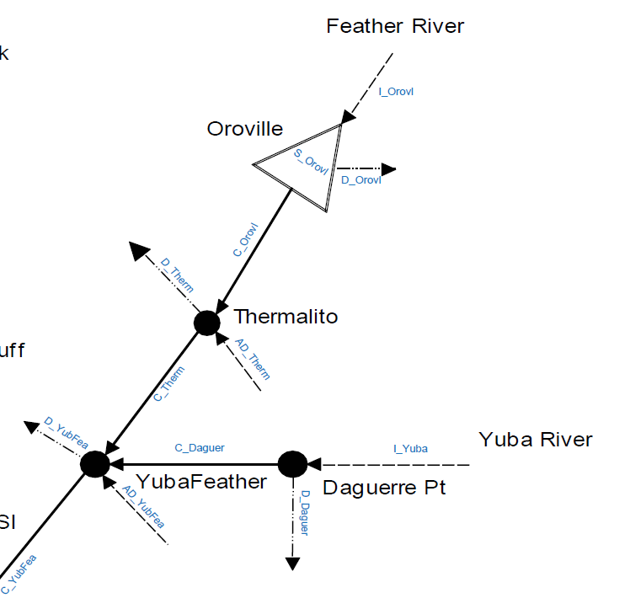
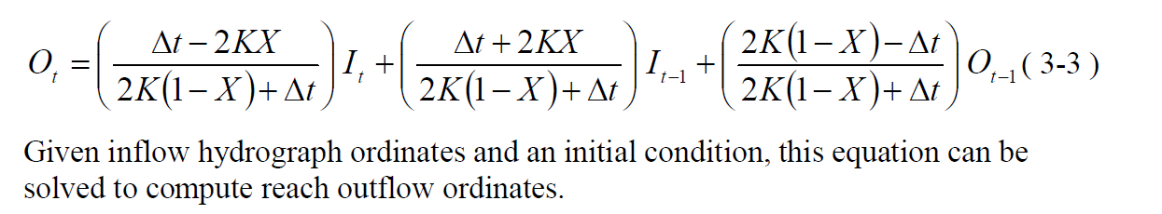
CalLite schematic
$$CTHERM=C_{0}COROVL+C_{1}COROVL\left(−1\right)+C_{2}CTHERM(−1)$$

Slide 9
Phase 1 data requirements
Lake Oroville
Inflow (TAF/day)
Initial storage
Level 5 storage
Evaporation rate
Oroville water rights demands
Minimum groundwater pumping

Slide 10
Thermalito demands and diversions
Region | Delivery Node | Project Delivery Type
Western Canal | D7A_PWR | Water rights
 | D7A_PAG | Agricultural
 | D7A_PRF | Refuge
Joint Canal | D7B_PWR | Water rights
 | D7B_PAG | Agricultural
 | D7B_PRF | Refuge
Rice decomp | D7C
Butte County | D201_PIMI | Indoor M&I
 | D201_POMI | Outdoor M&I
Thermalito Irrigation District | D202_PWR | Water rights

